Slide 1

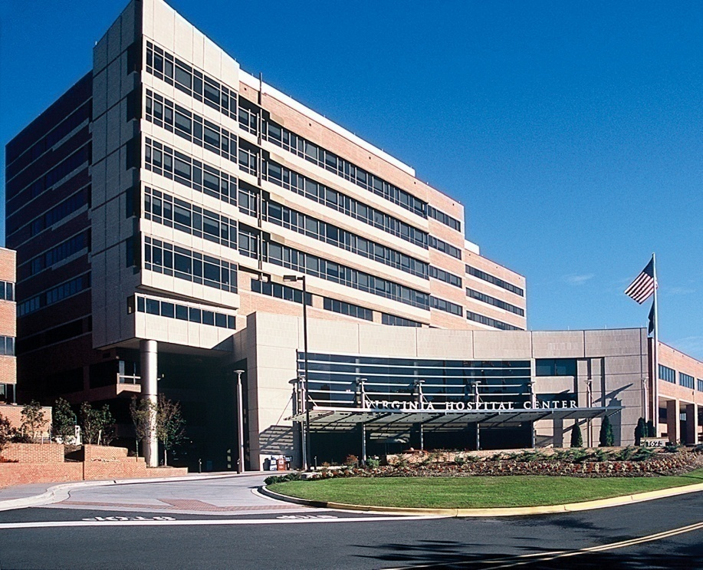
Virginia Hospital Center
Health System
Nuts and Bolts of Health System
Capital Purchasing
Healthcare Technology Network
April 24, 2015

Slide 2
Virginia Hospital Center
Health System
Quick overview of VHC

Slide 3
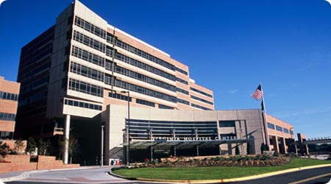
Virginia Hospital Center
Health System
Not-for-profit, 501(c)(3) 342-bed hospital
One of the few independent hospitals left in DC metropolitan area/Virginia
Only hospital in Arlington County
70-year history serving the Arlington, Northern Virginia & Metro communities
Teaching and research hospital associated with Georgetown University’s School of Medicine
$30.7 million in community services in 2013
Multispecialty physician group with over 140 employed physicians
South Campus includes the Arlington Pediatric Center, Arlington Urgent Care Center, Health and Wellness classes, diabetes education and addictions treatment services

Slide 4

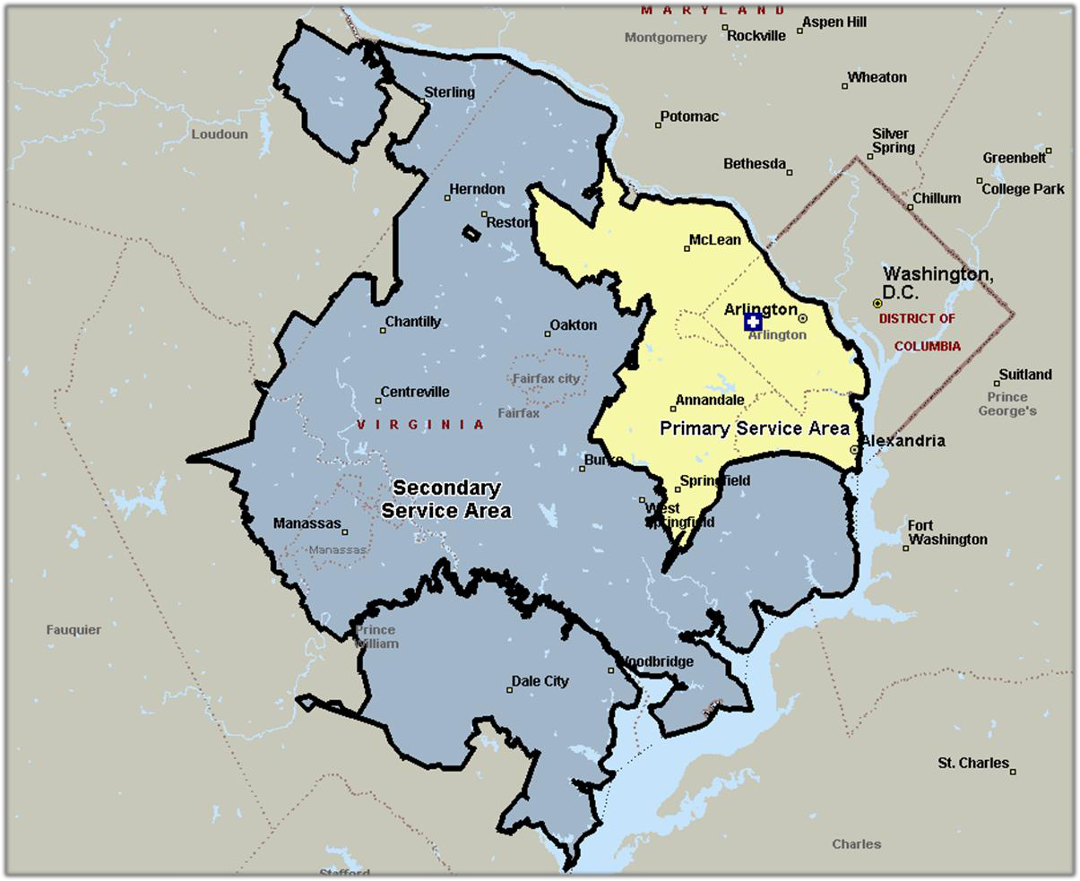
Virginia Hospital Center
Service Area
Key
Primary Service Area Secondary Service Area
Virginia Hospital Center Arlington Health System
INOVA Loudoun
Memorial Hospital
HCA Reston Hospital Center
INOVA Fair Oaks Hospital
Novant Prince William Hospital
INOVA Fairfax Hospital
INOVA Alexandria Hospital
INOVA Mount Vernon Hospital
Sentara Potomac Hospital

Slide 5
Virginia Hospital Center
Physician Group
Notes:
Focus=increase Primary Care presence in the community
Spread VHC brand and have it be “top of the mind” in the primary and secondary service areas

Slide 6

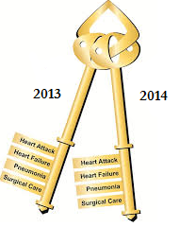






Quality

Slide 7
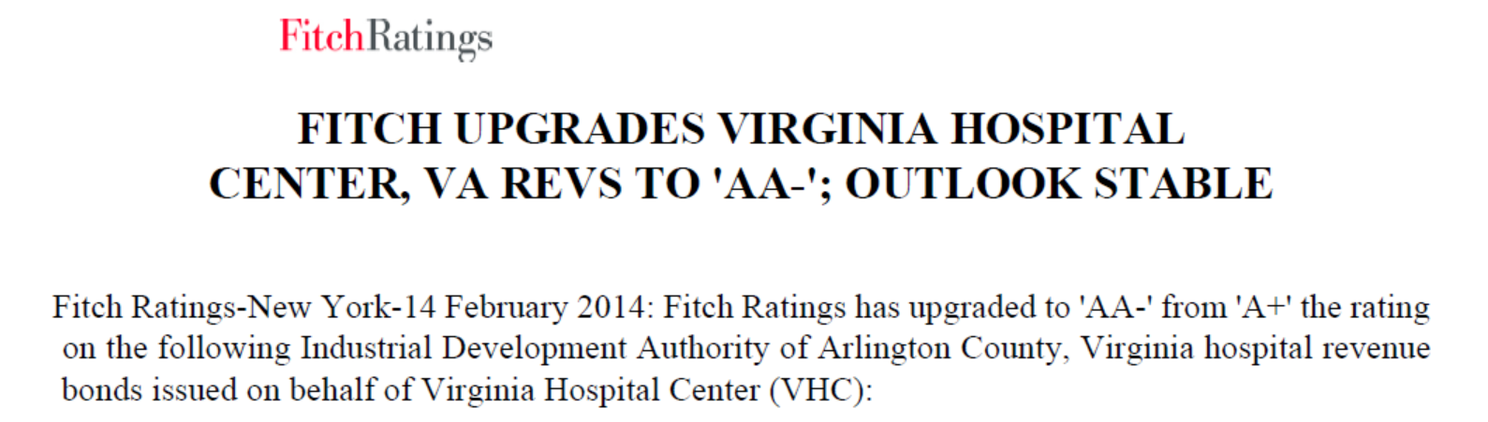
Bond [Credit] Rating
Key Rating Drivers: Excellent Liquidity, Strong Profitability
Maintained, Modest Capital Needs, Gaining Market Share

Slide 8
Virginia Hospital Center
Health System
How much do we spend?
When do we decide?

Slide 9
Available to Spend
Projected Cash from Operations $52M
Projected Cash from Fundraising $3M
Projected Cash Flow $55M*
Less: Debt Service $11M
Cash Available for Capital $44M
Savings (a/k/a cushion, set aside…) $14M
Capital Budget $30M
* May also include cash from investment or endowment earnings
Notes:
Savings used for very large projects – building replacement, EHR replacement

Slide 10
Timeline
Fiscal Year ends December 31
July – Spending limit set by Board
Sept/Oct – Executive review and prioritization
Nov – Finance Committee Review
July/Aug – Requests prepared
Dec – Final Board Approval

Slide 11
What is Capital v Operating?
> $1,000 and > two years => Capital Budget
Exceptions:
  Software - (expense unless > 4 years and > $10,000)
  Surgical Instruments - (expense unless > $10,000 and new service or MD)
< $1,000 & Equipment => Operating Budget
  704310 (> $500)
  704320 (< $500)
Notes:
These are the guidelines to follow when asking yourself is it Capital.
There are also separate expense accounts for Software and Instruments
704310 and 704320 can be used for Non Capital Equipment
Of course if you are unsure you can call me and we’ll figure it out.

Slide 12

Capital Budget
Manager Roles:
Coordinate with DFE for build out and Construction Needs
Coordinate with IS for connectivity/hardware needs
Meet with vendors to research your product
Research Alternative to Purchase
Expected Results of Purchases
Coordinate with Purchasing to Obtain appropriate Quotes
Communicate Budget Needs to Your Vice President

Slide 13

Vendor
Who do I approach?
  Executives?
  Department Managers/End users?
  Information Systems and Technology Management?
When do I approach?
  Every chance I get?
  Budget time?
  Response to RFP?

Slide 14

Where is your ROI?
ROI Costs include:
Equipment, Capital, Maint., Labor…..
ROI savings are:
Real cost reductions
Real Net Revenue/volume gains
ROI savings are not:
Time saving (Unless FTE’s reduced)
New charges

Slide 15

What if it isn’t budgeted?
Executives may substitute funding for a new priority
Board authorization for additional funding (very, very rare)
Wait until the next cycle

Slide 16
Virginia Hospital Center
Health System
What do we spend it on?
How do we prioritize?

Slide 17
Five Year Spend
In 000’s

Slide 18
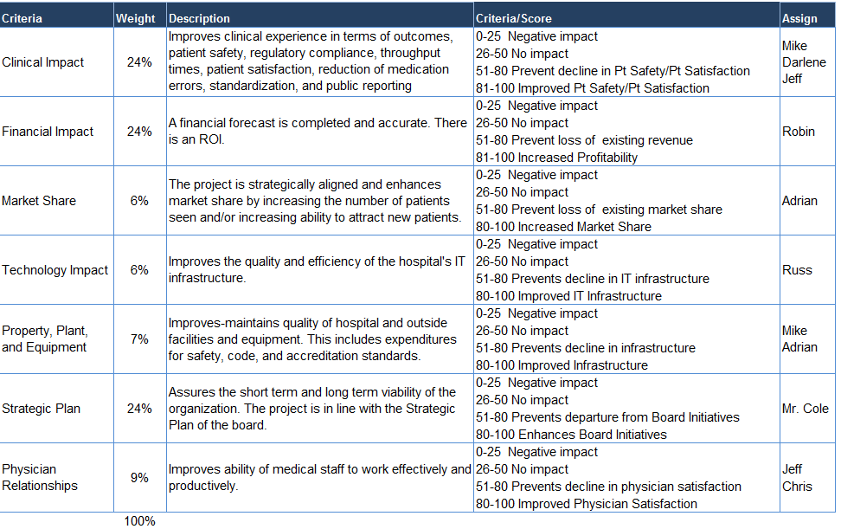
Prioritization Approach
Notes:
Projects > $100k

Slide 19
Virginia Hospital Center
Health System
Cash, Lease, or Debt?

Slide 20

Robin’s Rules for Financing
1. Use Cash whenever possible.
2. Never use long term debt to finance a purchase that will be used for less than 10 years (ie any IT project).
3. Leasing is the most expensive form of financing. Avoid it.
4. When in doubt, see rule #1.

Slide 21
Virginia Hospital Center
Health System
Closing Thoughts

Slide 22


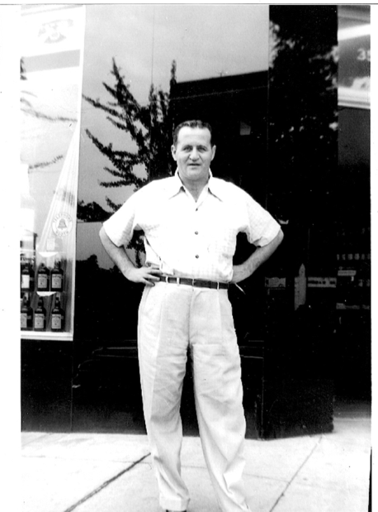
Why am I in Healthcare?
A fortunate accident

Slide 23

Put the Patient First…

Slide 24
Robin Norman, Senior VP/ CFO RNorman@virginiaHospitalcenter.com
Capital Acquisition

